Slide 1


Protest Policing in Patriarchal-Patrimonial Systems: A Multiphase MM Study of Police-Elite Relations and Gendered Policing in Georgia
Gvasalia, Tamari

Slide 2
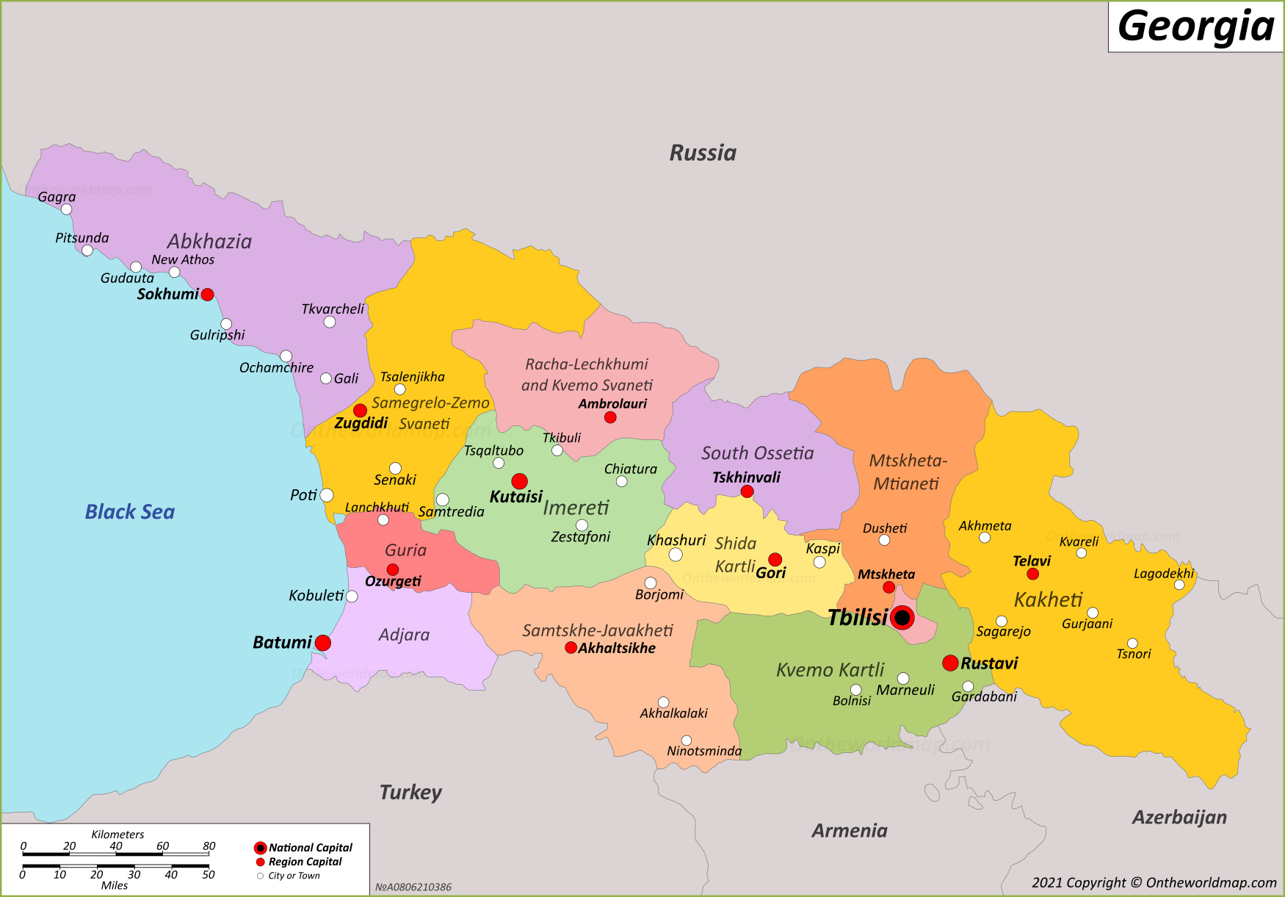
Context Overview
Russia continues to occupy 20 percent of Georgia’s territory

Slide 3
Context Overview
Few words about Georgia
A member of former Soviet Union with the successful experience of democratic transition and EU candidacy status
Strong civil society, history of resistance and women’s active role in protest & activism
Changing Geopolitical trends after Russia’s war in Ukraine, Russian propaganda, attack on civil society, corrupted elections, termination of EU membership negotiations and a year-long protest
500 people have been arrested on administrative charges, and criminal cases were opened against 44 individuals, including journalists, activists, students, professors, and researchers, most of them were women (November 2024-January 2025)

Slide 4
RESEARCH OVERVIEW
What do I explore?
How people affected by protest policing perceive police - ruling elite’s relationship; what role if any police culture play in this relationship?
What is women’s experience of protest policing and why?
What is people’s perspective of acceptable policing?

Slide 5
RESEARCH OVERVIEW
What I aim with this research?
Identify a root cause of oppression by focusing on the prevailing power structures (police & ruling elites) and relationships between the oppressors and the oppressed (police, elites, protest participants);
Create a platform for the people effected by protest policing to make their voice vocal in academic research, feelings and interpretation of their reality expressed and listened;
Promote bottom - up changes based on people’s experience and willingness.

Slide 6
Methods and Methodology
What I do to achieve my goals?
Explore protest policing - how police manage protests
Listen to lived experiences - participants’ perspectives
Compare perspectives - what are police perspective
Explain the trends - Gender experts’ perspective
Type of the research: Mixed-Methods study within the framework of Critical Dialectical Pluralism;
Analytical Framework: Max Weber’s theory of Patrimonialism
Methods:
Phase I – Survey & Semi-Structured interviews with protest participants
Phase II - Semi-Structured interviews with police officers & gender experts

Slide 7
Phase I Preliminary Findings
Participant’s perception of police-elite’s relations
Police in the service of regime - an instrument of political survival
Political narratives in policing practice
Propaganda and police ideologization
Women’s experience of protest policing
Changes in police attitude towards the women
Woman as a target of police
Intolerance of vocal women
Political interactions with women during the protest
Humiliation and sexual harassment

Slide 8
Next Steps & Challenges
Next Steps
Interviews with former and current police officers
Interviews with experts working on women’s issues in Georgia
Challenges:
Sensitive political context
Sensitive research topic / safety risks for participants
Positionality and researcher’s safety risk

Slide 9
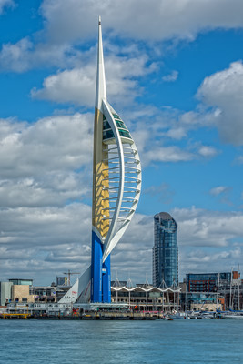
Thank you for listening

