Slide 1

What is possible when autistic young people are partners in research design?
Nikki Smith
University of Brighton
n.smith24@uni.brighton.ac.uk
Notes:
Ref: Neurowild - https://www.neurowild.com.au/category/all-products

Slide 2

Why is participatory research important?
Historically there is a gap between the priorities of the autistic community and the priorities of researchers
Lack of research that is co-produced
Often autistic adults are designing research for autistic young people to participate in
(Gowen et al., 2019; Costley et al., 2021; Pellicano and den Houting, 2022)

Slide 3
The Autism advisory group (AAG)
Thinking about the ethical aspects was important
Would they sit in silence feeling uncomfortable?
Power dynamics
One member was my son - is this ethical?
Would they feel coerced into doing it due to previous relationships with me

Slide 4
The AAG discussed the research question
Support from staff
Sensory aspects
Understanding and acceptance
Mental health
Classrooms/Lessons
Social aspects
Communal areas
Exams
The working research question:
What are the different ways that autistic young people of all genders experience mainstream secondary school?

Slide 5
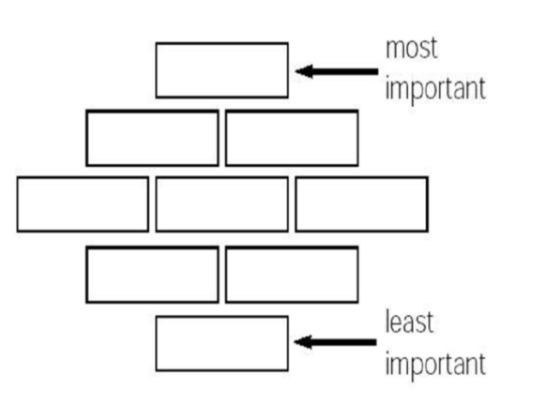
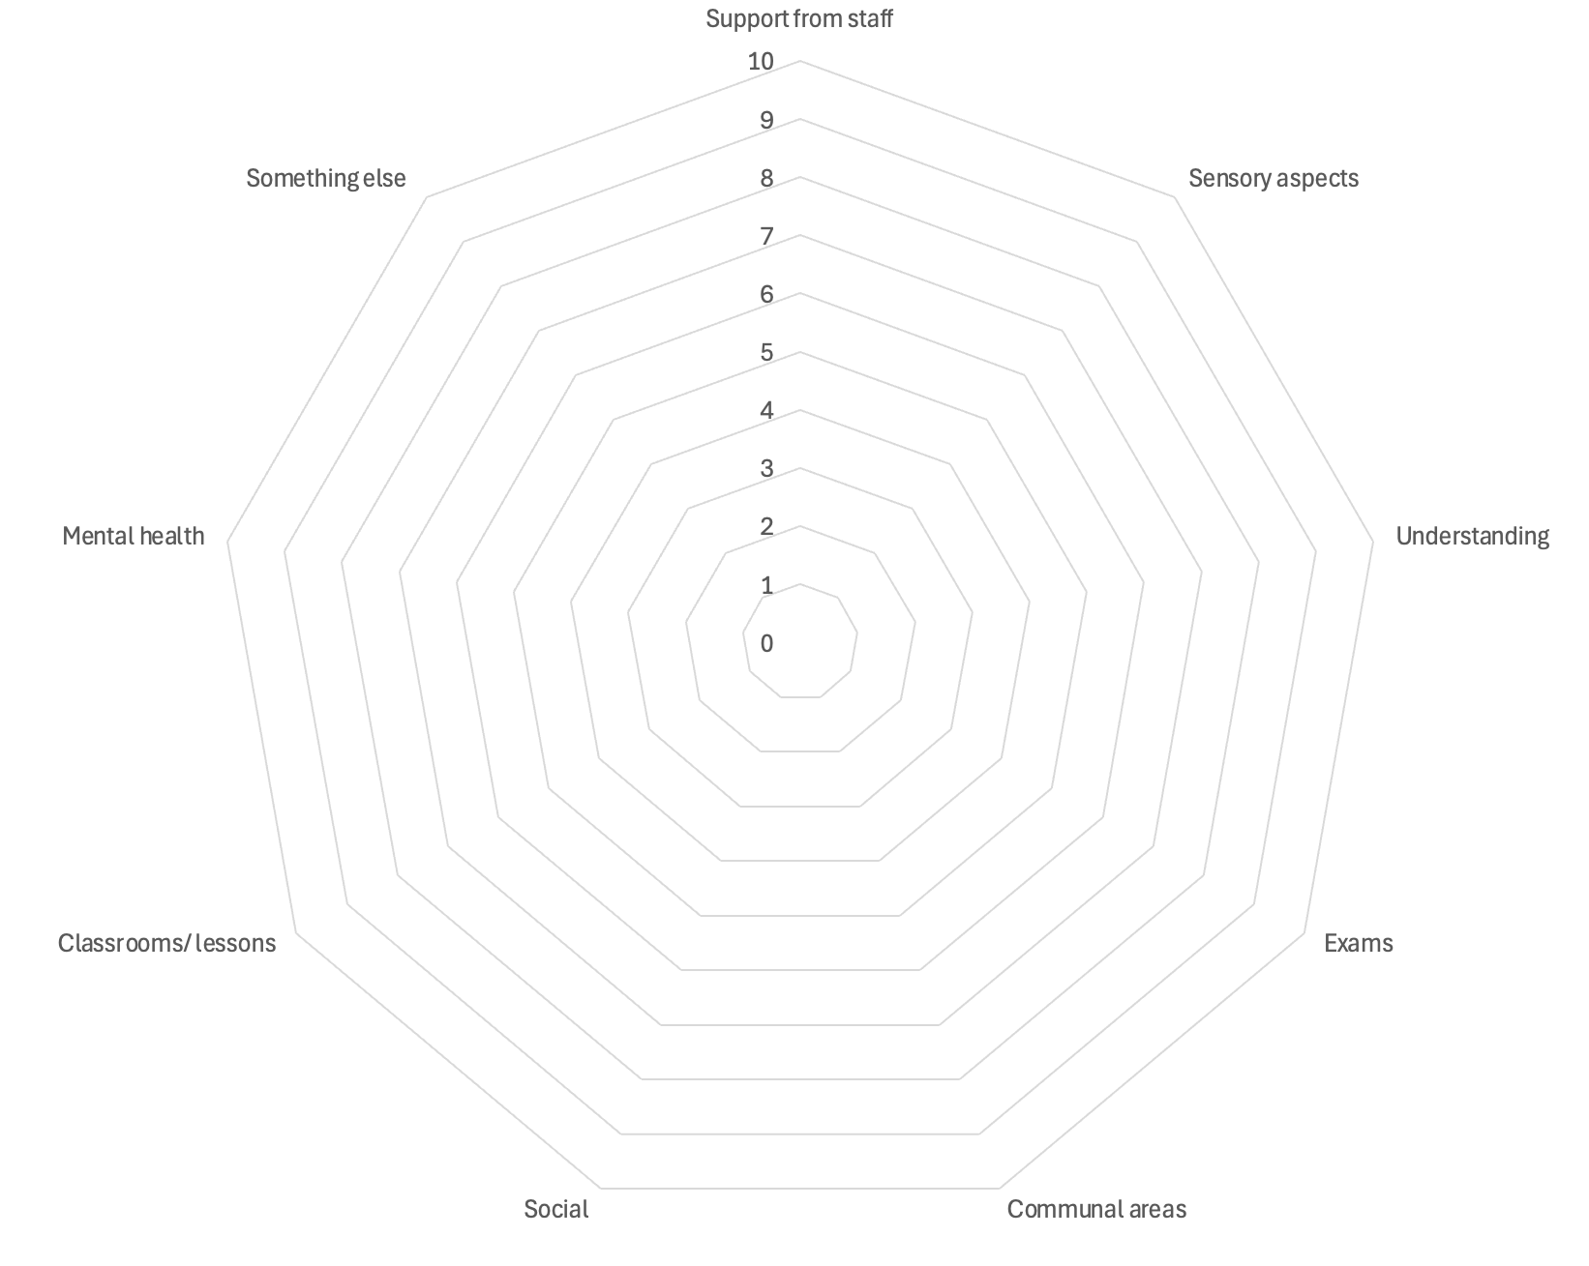
Subgroups
Support from staff
Sensory aspects
Understanding and acceptance
Mental health
Classrooms/Lessons
Social aspects
Communal areas
Exams

Slide 6
Subgroups
Support from staff
Sensory aspects
Understanding and acceptance
Mental health
Classrooms/Lessons
Social aspects
Communal areas
Exams

Slide 7

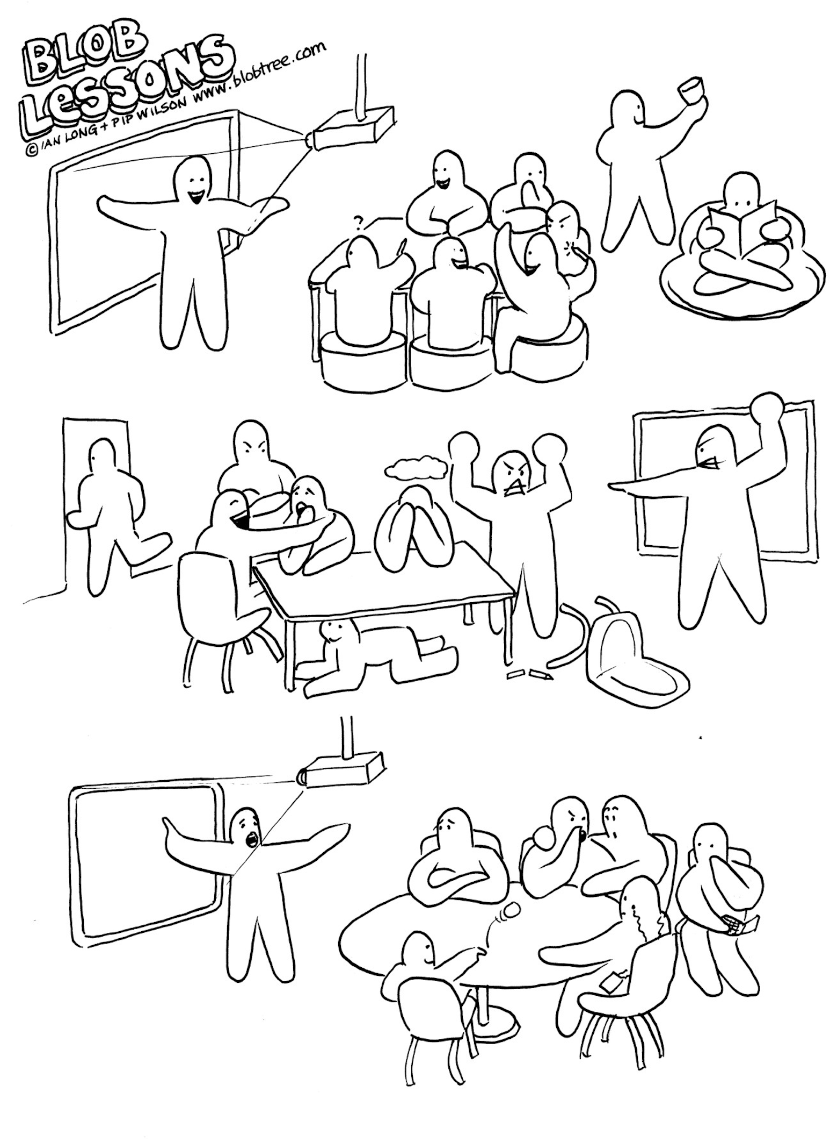

Slide 8
Statements

Slide 9
I want to get good exam results
I get help from school staff when I need it
I feel accepted by other students
I learn about things that interest me at school
School is an easy place to be
I like to know why I’m learning something
No
I enjoy PE
I can walk through the corridors easily
Yes
I get bullied
I am proud of my achievements at school
Sometimes
I can be myself at school
I have a sense of belonging at school
I like going to school
I feel safe at school
The classrooms are clean and comfortable
The teachers care about me
I have good friends at school
I feel that I can put my hand up and answer a question at school
The teachers treat me fairly
I eat in, or get my food from the canteen
Notes:
So the venn diagram if the interviews take place online -

Slide 10
Meeting 2 - subgroups
Support from staff √
Sensory aspects → e.g. sound, smell, light, textures
Understanding → Being understood by staff and peers
Mental health → Classroom environment
Classrooms/Lessons → content of lessons (curriculum and teaching)
Social aspects → relationships with peers (friends)
Communal areas → unstructured time e.g. break, lunch, lesson changeover
Exams √
Something else (if applicable)

Slide 11
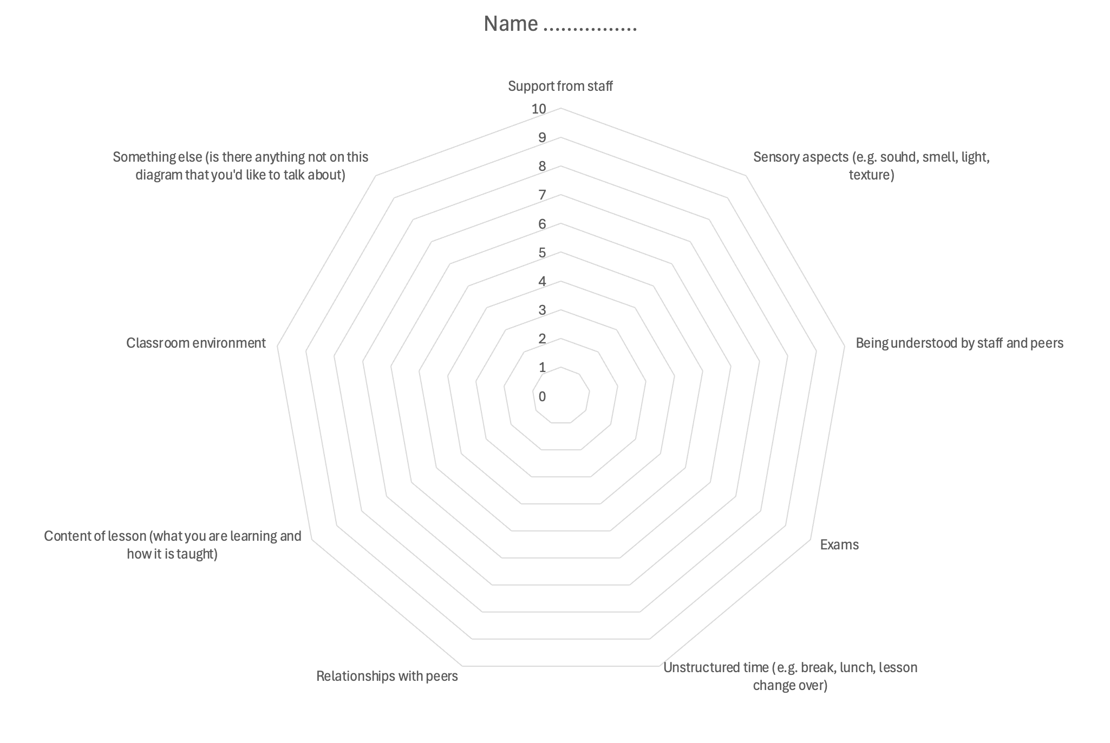
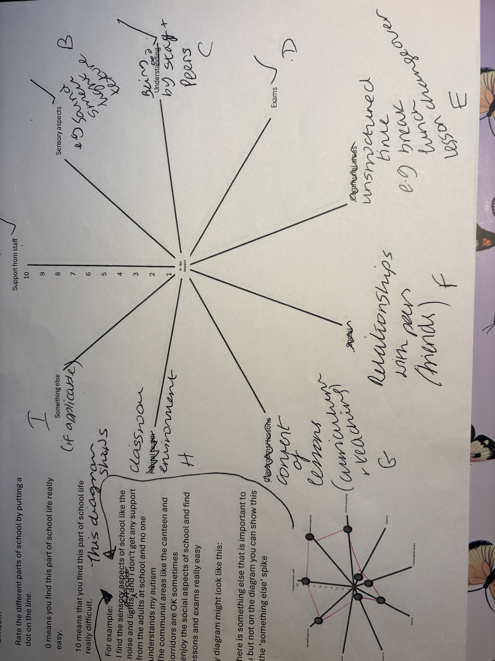
Subgroups 2
0 - No impact

Slide 12
Subgroups 2

Slide 13
I want to get good exam results
I get help from school staff when I need it
I learn about things that interest me at school
School is an easy place to be
I am accepted by other students
I enjoy PE
I can walk through the corridors easily
I like to know why I’m learning something
Yes
No
I can be myself at school
Sometimes
I am proud of my achievements at school
I get bullied at school
I have a sense of belonging at school
The teachers care about me
I put a lot of pressure onto myself to do well at school
I like going to school
I feel safe at school
The classrooms are clean and comfortable
At break times there is a space that I am happy to spend time in
I put my hand up and answer questions in lessons
I have friends at school
I use the canteen
The teachers treat me fairly
I eat in, or get my food from the canteen
Notes:
So the venn diagram if the interviews take place online -

Slide 14
To finish….
“I wonder if something that we could address, in terms of mental health is instead of looking at mental health as a whole, we could look at what could lead to a deterioration in mental health and sort of trying to pick up on root causes and then how those things could be addressed”
Meeting 1 – S1

Slide 15
References
Costley, D. et al. (2021) ‘The Anxiety Caused by Secondary Schools for Autistic Adolescents: In Their Own Words’, Education Sciences, 11(11), p. 726. Available at: https://doi.org/10.3390/educsci11110726.
Gowen, E. et al. (2019) ‘Guidelines for conducting research studies with the autism community’, Autism policy & practice, 2(1 A new beginning), pp. 29–45. Available at: https://www.ncbi.nlm.nih.gov/pmc/articles/PMC7099931/ (Accessed: 23 August 2024).
Pellicano, E., Dinsmore, A. and Charman, T. (2014) ‘What should autism research focus upon? Community views and priorities from the United Kingdom’, Autism, 18(7), pp. 756–770. Available at: https://doi.org/10.1177/1362361314529627

