Slide 1
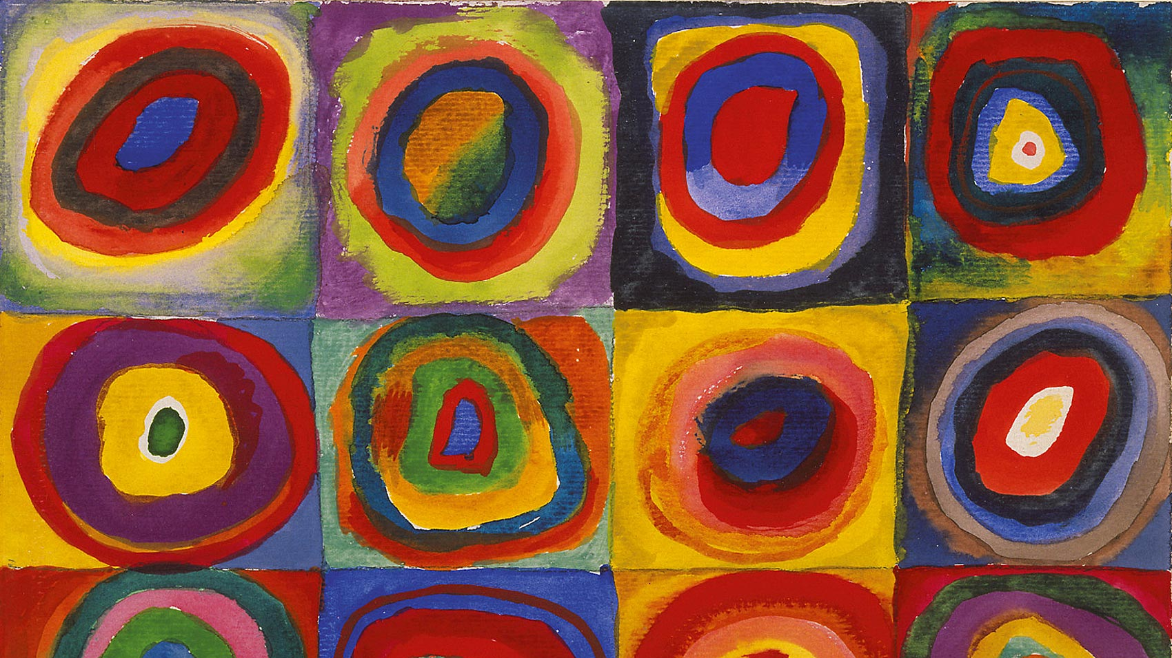
What is my approach to interviewing people considered vulnerable?
Ramon Olads
PhD. Candidate - UoB – SCDTP – ERSC
October/2025

Slide 2

AM I VULNERABLE?
Main aspects of my research:
Why?
I interviewed 33 people – 27 of them had been victims of hate crimes at some point
Six months working with two NGOs in Salvador (Brazil), following and documenting reports from victims of hate crimes
After all, who is vulnerable?
“All of Us Are Vulnerable, But Some Are More Vulnerable than Others: The Political Ambiguity of Vulnerability Studies, an Ambivalent Critique” (Cole, A., 2016).
Are all LGBTQ+ individuals vulnerable?
“The challenges of international research in developing countries require an understanding of how new vulnerabilities arise from conditions of economic, social and political exclusion. Therefore, vulnerability as a label fixed on a particular subpopulation” (Luna, F. (2009).

Slide 3
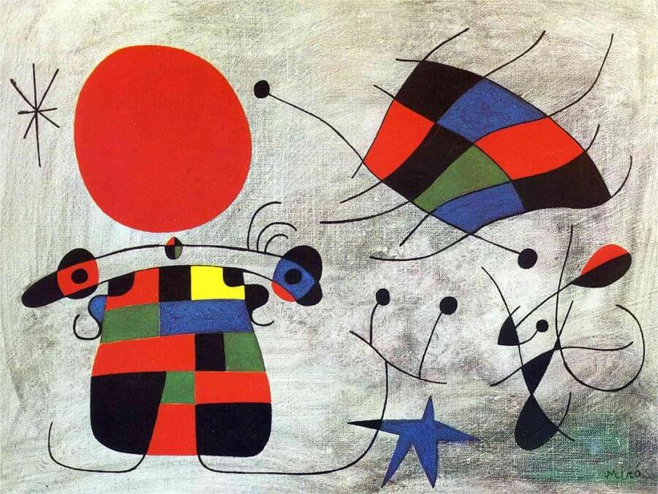
Working with vulnerable groups in social research: why?
Key Dilemmas in Research with Vulnerable Participants
Research with vulnerable participants involves inherent dilemmas related to:
Research governance and ethics → ensuring protection for both participants and researchers. Risk assessment.
Interpretation and representation → Do participants want to be seen as “vulnerable”?
Insider/Outsider.
“We do not have time for self-pity, just be professional and show you want to translate their pain into voices, not only as data”. (Sam, 23y – Activist)

Slide 4

What about me? Aren’t I an intellectual?
1. Qualitative Methods: Participatory Action Research (PAR)
PAR promotes:
Inclusion, empowerment, and recognition of participants’ voices.
Active involvement at all stages of research.
Core idea: They are participants, not subjects.
2. Focus on “Voice” and Inclusion
Participant stories and voices at the centre.
Promotes empathy, democracy, and resilience - “Inclusive research”: participants as initiators, writers, and disseminators.
3. The Concept of “Voice”
“Voice” = literal, metaphorical, and political.
Brings unheard voices into academic and professional spaces.
Encourages agency and co-production through creative tools:
Cameras, video, art materials.

Slide 5
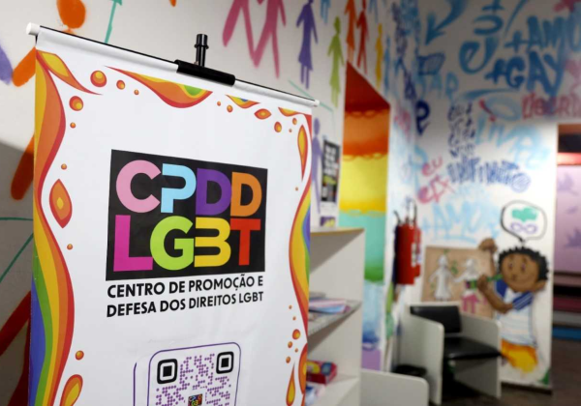
“Thank you”
The concept of vulnerability offers a more effective approach to addressing inequality than traditional legal methods, which often only intervene after harm has occurred.
NGO – CPDD -Photograph by the author, 2025.
Reference:
Cole, A. (2016). All of Us Are Vulnerable, But Some Are More Vulnerable than Others: The Political Ambiguity of Vulnerability Studies, an Ambivalent Critique. Critical Horizons, 17(2), 260–277. https://doi.org/10.1080/14409917.2016.1153896

